Slide 1

Twitter sentiments on nuclear energy/ power
Ckme 136: Data analytics Capstone
By Earvin Sahayathasan

Slide 2
Literature review on Nuclear power
Bi polar opinions about nuclear power exists where people heavily agree and disagree
Pros
Power supply that can last and be utilized efficiently for a long period of time
Can be a better compromise to the gas industry because in comparison produces less emissions
Provides plentiful jobs and opportunities
Cons
Causes emissions compared to renewable energy sources
Has been shown to kill and damage individuals with contamination
Has killed people due to misuse of power such as Fukushima bombings

Slide 3
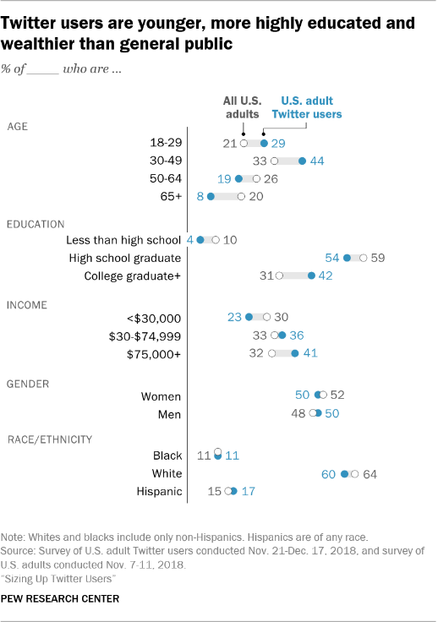
Literature Review on Twitter
People voice opinions on important topics on twitter so extracting data from this topic is so prevalent
The average age of a twitter user who is considered highly educated is around 30 – 34
The average income of twitter users considered highly educated are predominantly 30 – 70 K salary
These stats provide an understanding of the demographic and lifestyle people are in when they voice their opinion

Slide 4
Research Question
What are the most common words to provoke positive opinion? Negative opinion?
What problems are shown to most impact negative opinion?
Is there any tweets that do not pertain to nuclear energy such as outliers that will not help with the general consensus?

Slide 5
Dataset
Open Source: Data For Everyone
Site: https://www.figure-eight.com/data-for-everyone/
CSV File
3 Features, 191 Tweets
3 Features
Twitter Tweet
Sentiment
Sentiment Confidence Summary

Slide 6
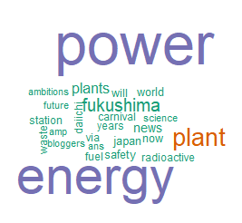
Text mining
Created Wordcloud from the most common words of the dataset
Wordclouds were used to visualize the text mined words by separating words into a matrix and counting each

Slide 7
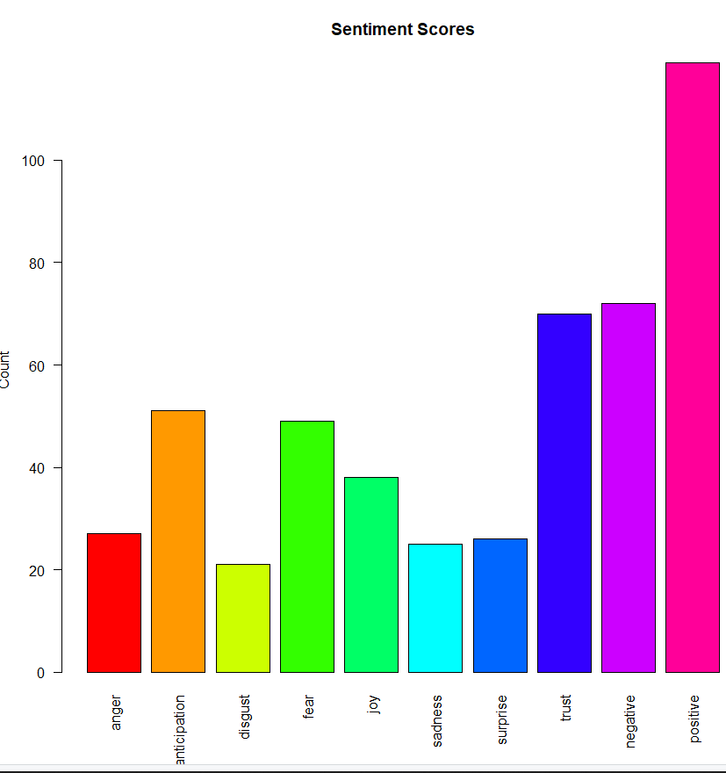
Sentiment Analysis
The sentiment scores for each tweet
The positive and negative are the sentiments for which the tweets were rated
The sentiment scores were given to each tweet based off the number of words that are positive and negative and adds them together to give a score to decide a rating

Slide 8
conclusion
In the end, the tweets were heavy towards the positive to use of nuclear power. The people that use the power are typically stating how the nuclear energy is a good use. The common words as stated before was power, which implies how people bring up the positive energy source that it is. The cons were typically correlated to the Fukushima incident where the problem was the harm it did in that tragic incident from the bombing.

Slide 9
Thank you For your time

